Slide 2
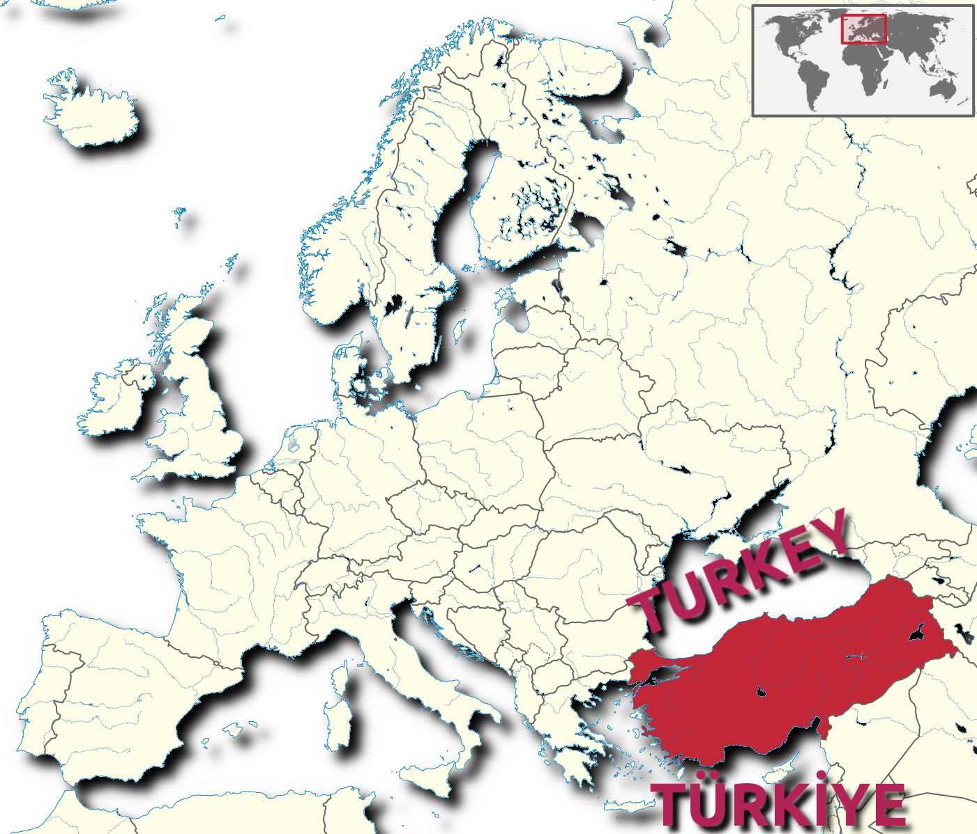

Slide 3
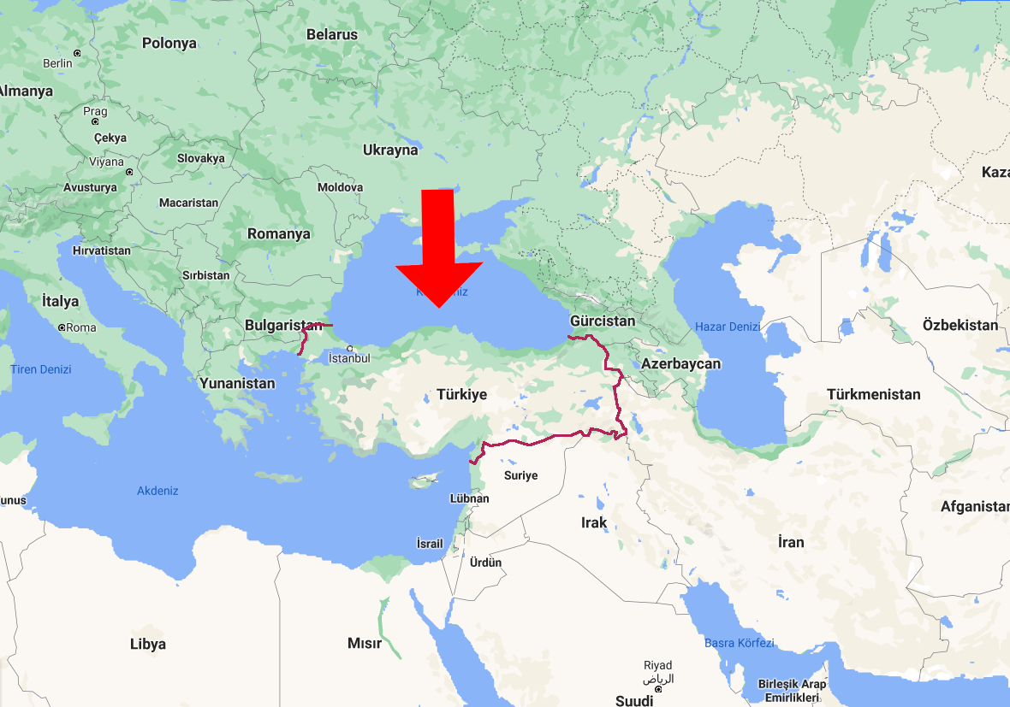

Slide 5
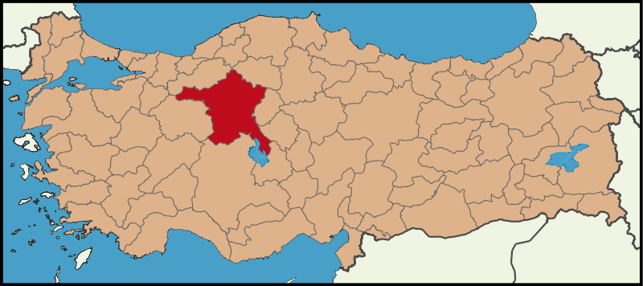

Slide 6
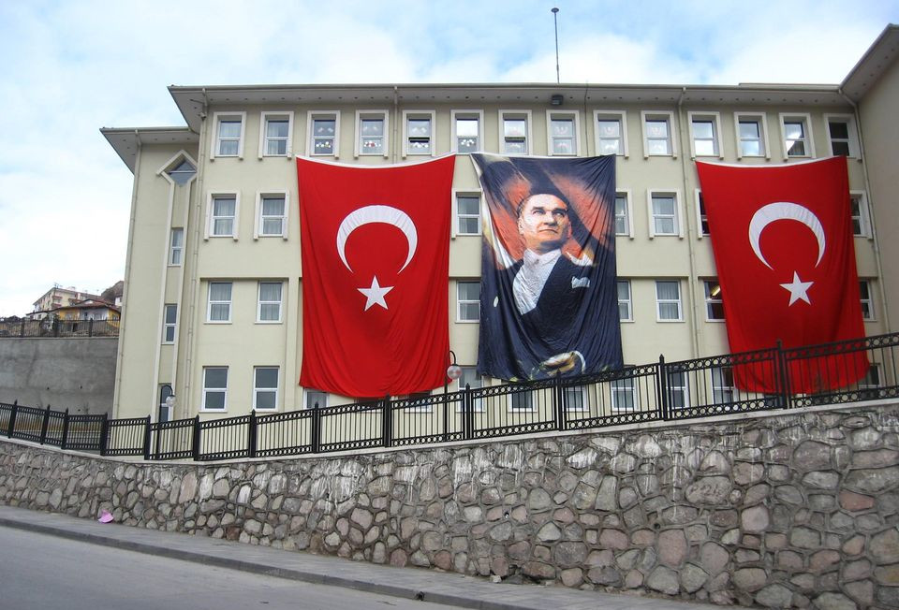
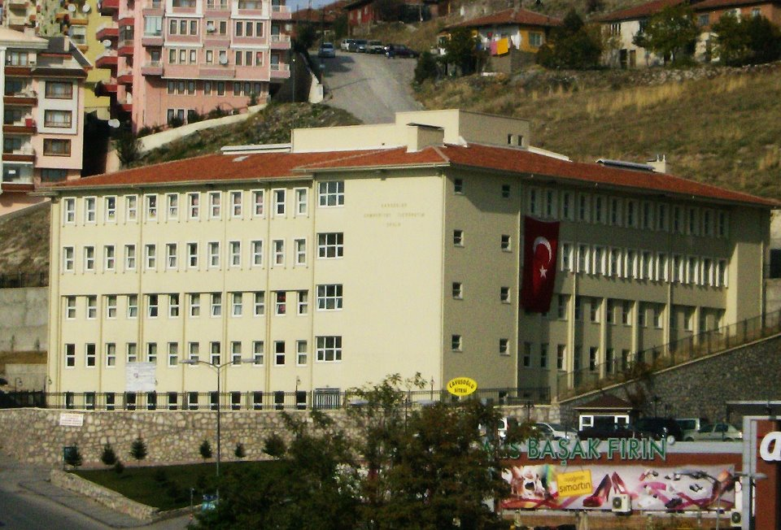

Slide 7
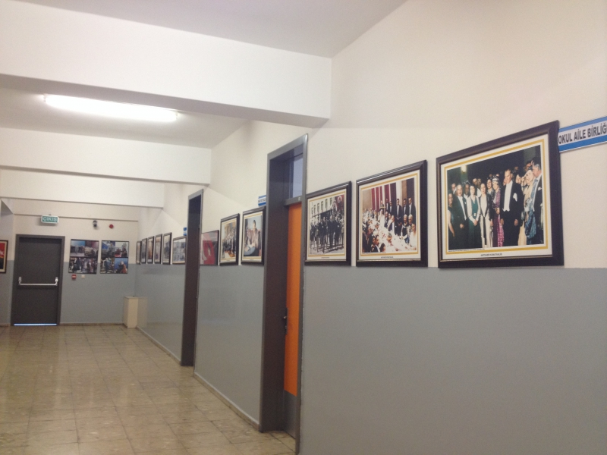
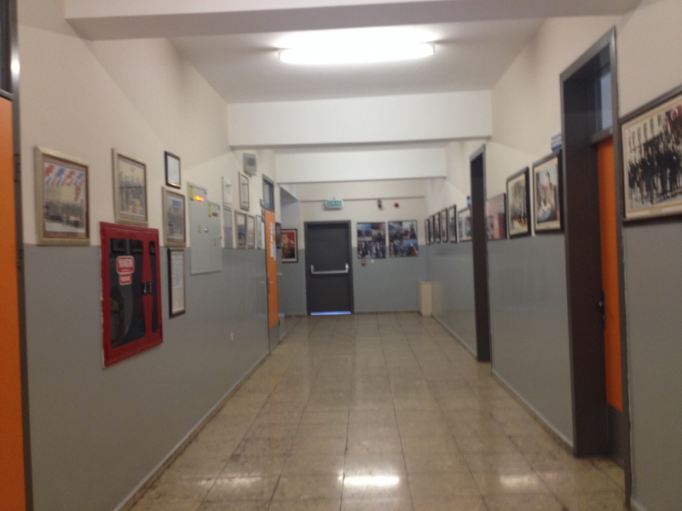
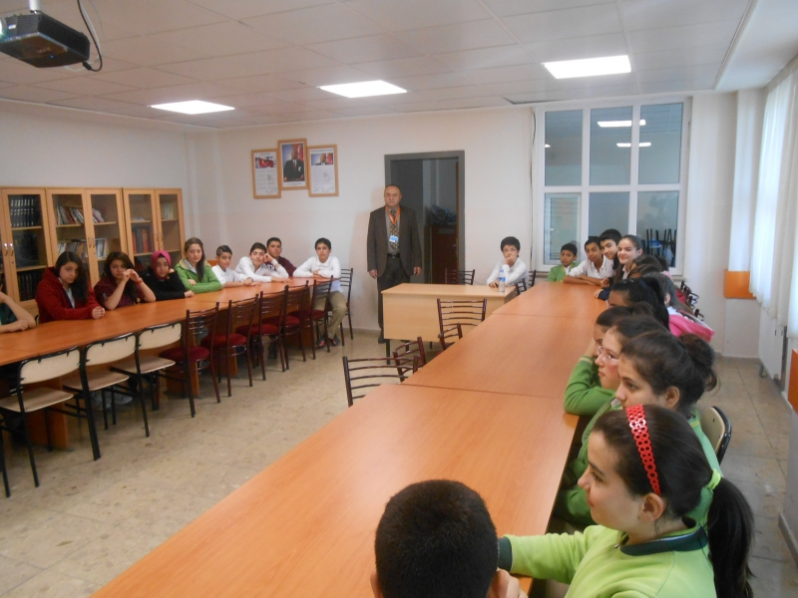

Slide 8
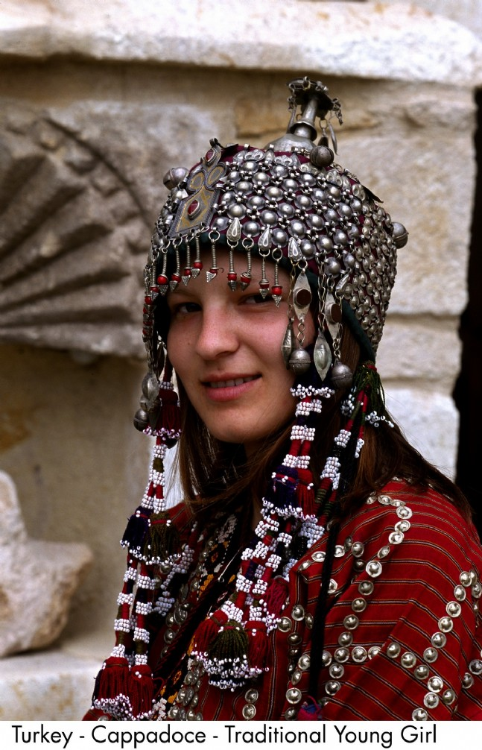
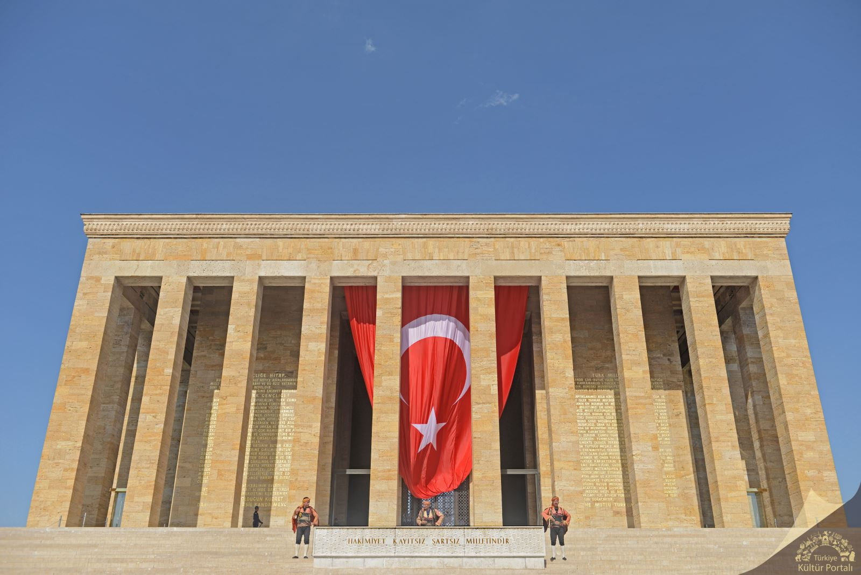
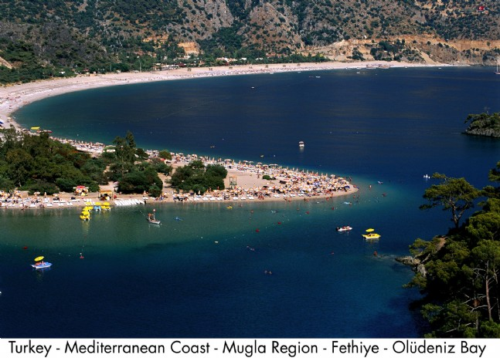
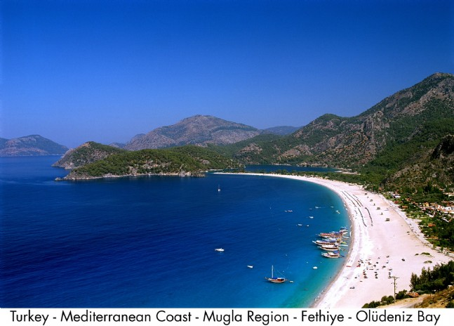
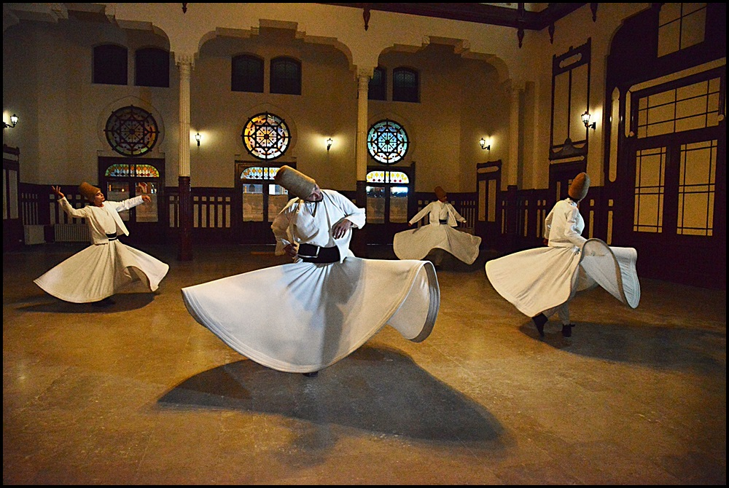

Slide 9
We want to present you
some Turkish rhymes and
simple songs.

Slide 10
if only life would be like a feast
hayat bayram olsa
Turkish folk song
The happiest person in this world is the one who gives happiness
The loved person in this world knows how to love
The strongest person in this world is the one coming from hardship The wisest person in this World is the one who knows himself
If only the whole world believed this ,
If only a belief,
if only life would be like a feast,
If only people holded hands
If only there was unity
If only we stretched together forever ……

Slide 11
row, row your boat
fış fış kayıkçı
nursery rhyme 1
Row, row, row your boat Gently down the stream Merrily merrily, merrily, merrily Life is but a dream
Fış fış kayıkçı Kayıkçının küreği Hop hop eder yüreği Akşama fincan böreği Yavrum yesin büyüsün Tıpış tıpış yürüsün
https://www.youtube.com/watch?v=T7gU4S9jTD4

Slide 12
Long live our school
daha dün annemizin
Daha dün annemizin Kollarında yaşarken
Çiçekli bahçemizin Yollarında koşarken
Şimdi okullu olduk ,Sınıfları doldurduk
Sevinçliyiz hepimiz ,Yaşasın okulumuz
Just yesterday we were in our mother’s arms
While we were running on the way of our garden full of flowers,
We are schooled now, we’ve filled the class
We are all happy now
Long live our school☺
nursery rhyme 2
https://www.youtube.com/watch?v=0oDtKe72JkE

