Slide 1
TAB
Together Against Bullying
ERASMUS+ KA229 _2020-22
2020-1-PL01-KA229-081653_5

Slide 2
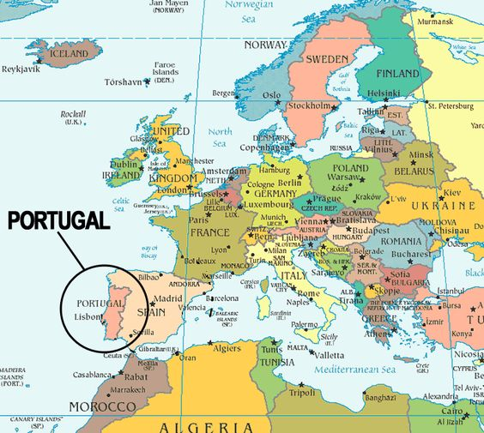
TAB
Together Against Bullying
Where is Portugal in Europe?

Slide 3
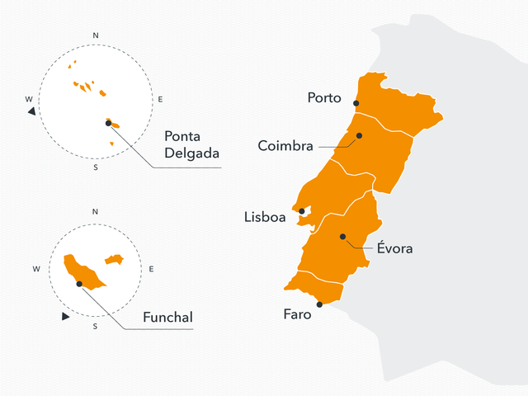
TAB
Together Against Bullying
Portugal has one continental part and two islands in the Atlantic Ocean
Azores
Portugal
Madeira

Slide 4
TAB
Together Against Bullying
Portugal Flag

Slide 5
TAB
Together Against Bullying
CAN’T SKIP HOPE

Slide 6
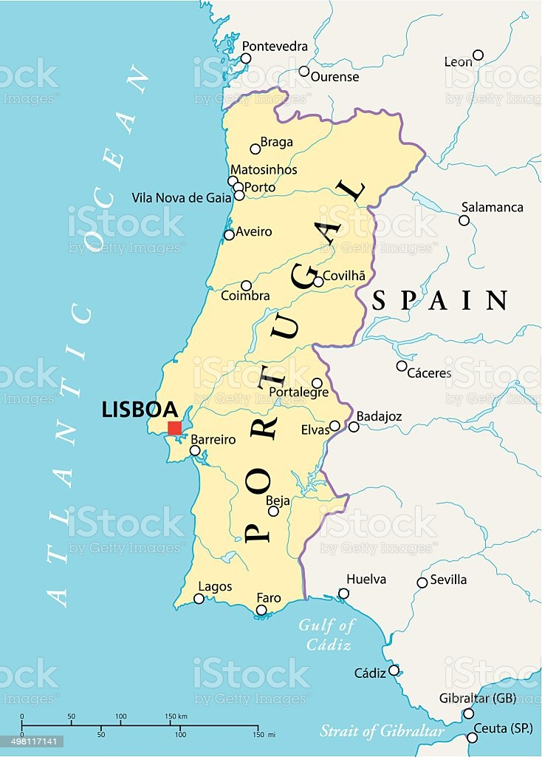
TAB
Together Against Bullying
Our City
BARREIRO
Portugal capital

Slide 7
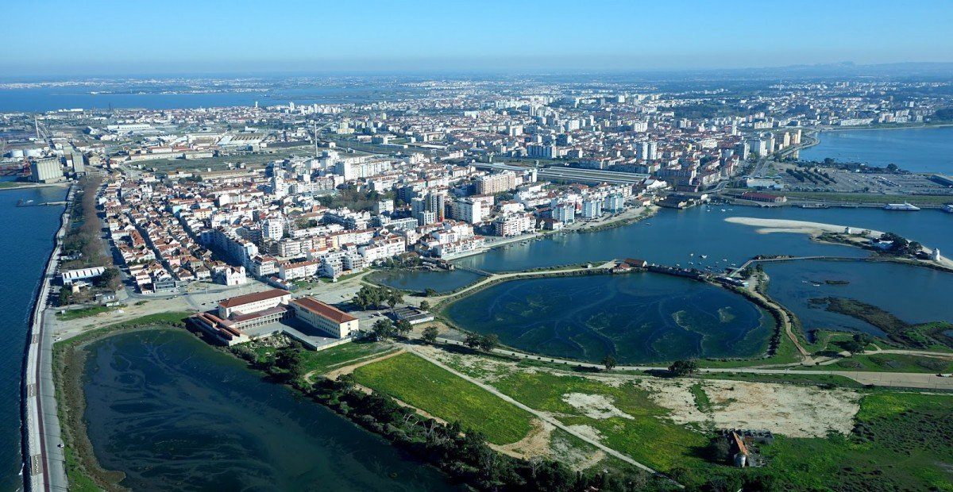
TAB
Together Against Bullying
BARREIRO
Our City

Slide 8
TAB
Together Against Bullying
Barreiro, the city

Slide 9
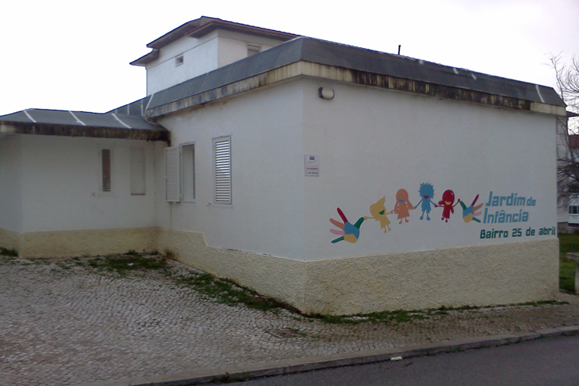
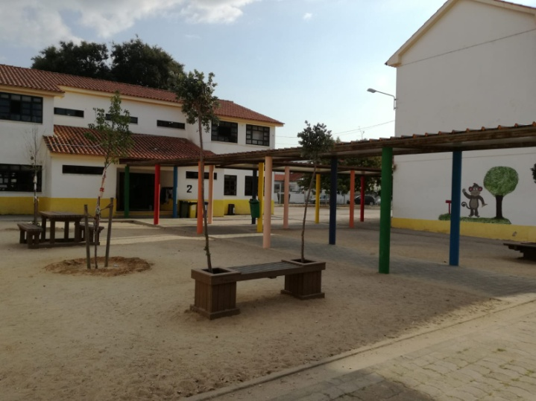
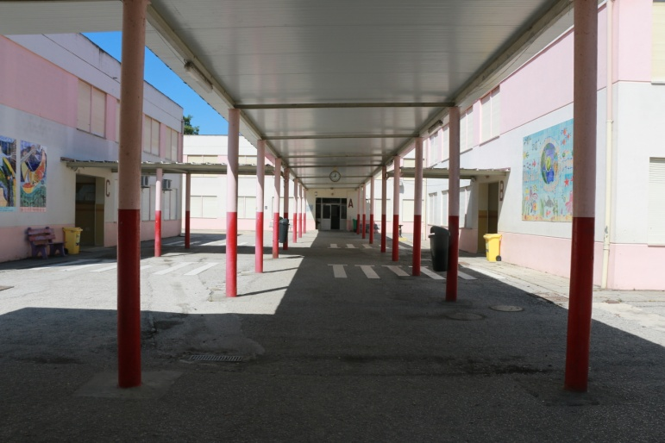
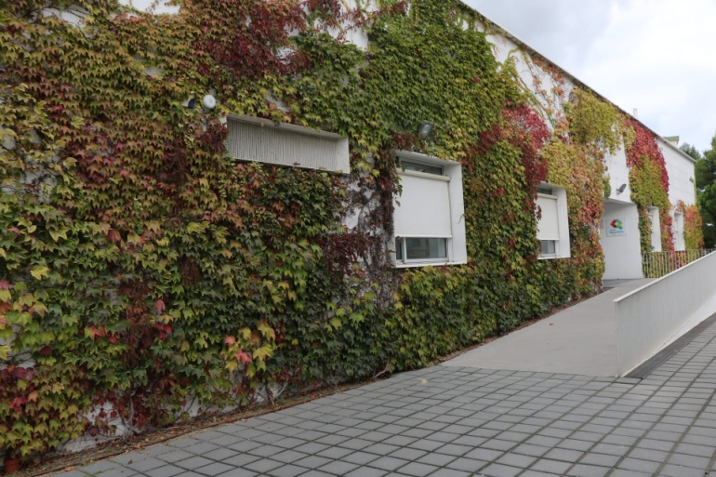
TAB
Together Against Bullying
Our School Cluster
Kindergarden
Primary School
Middle/Secondary School
High Secondary School

Slide 10
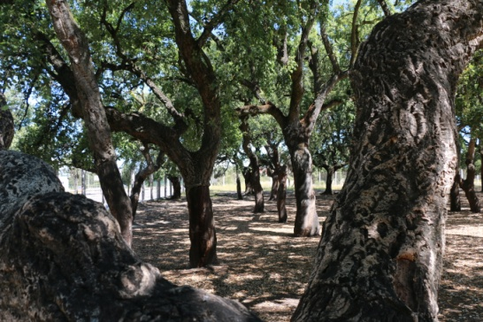
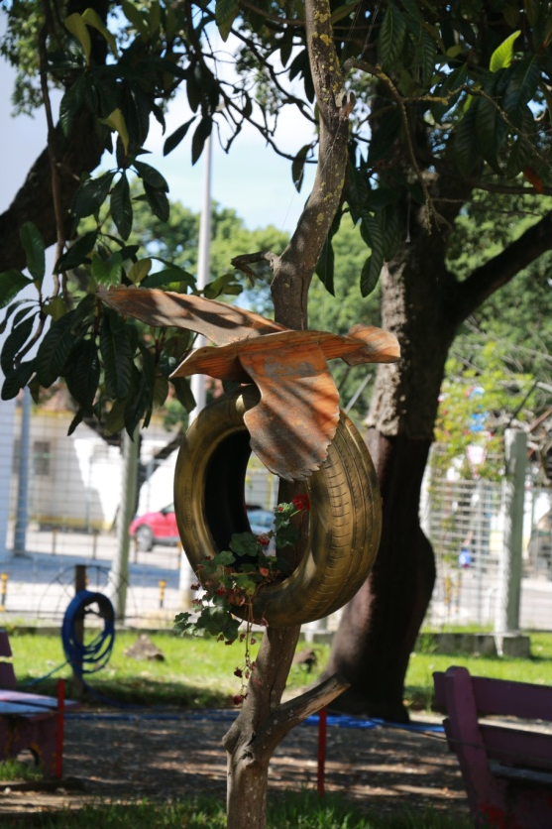
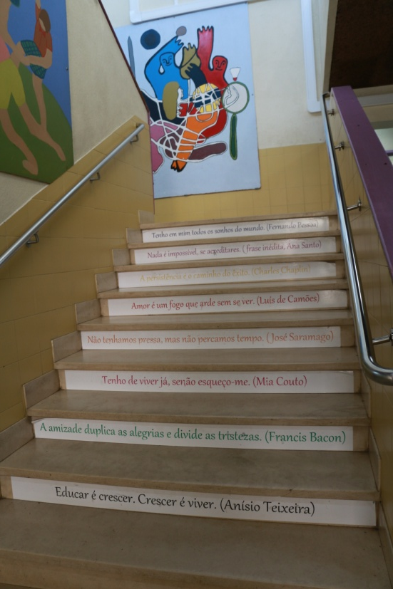
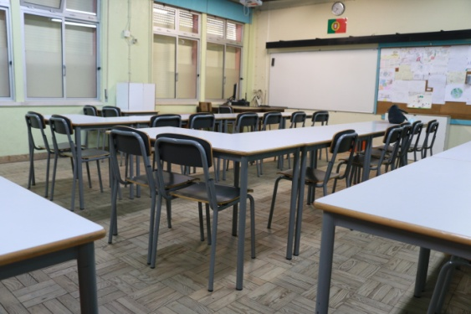
TAB
Together Against Bullying
Our middle school
Escola Básica 2, 3 Quinta da Lomba

Slide 11
TAB
Together Against Bullying
Movie of Welcome New School Year 2020-2021

Slide 12
TAB
Together Against Bullying
Lengalenga
is a song transmitted from generation to generation in which certain words or expressions are repeated
The Time
Time asked Time
How much Time has.
Time told Time
That Time has as much time
Has much time as Time has.

Slide 13
TAB
Together Against Bullying
Sou uma taça
I’m a cup
Children song of the present

Slide 14
TAB
Together Against Bullying
Portuguese words
Bom dia
Olá!
Amigo
Amizade
Abraço
Respeito
Paz
Good morning
Hi!
Friend
Friendship
Hug
Respect
Peace

Slide 15
TAB
Together Against Bullying
This is us…
Obrigado!
Thank you!

